Slide 1

4-1: Create a lively visual metaphor or analogy
By Barbara Oakley, PhD

Slide 2
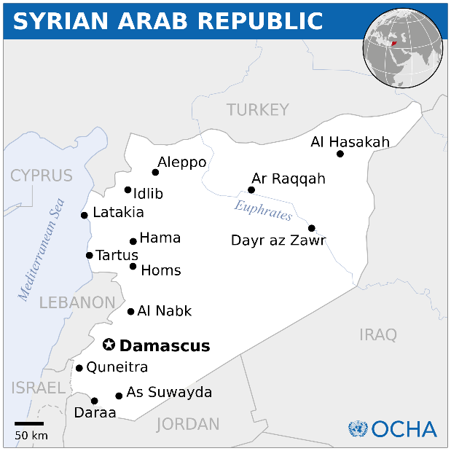

Slide 4
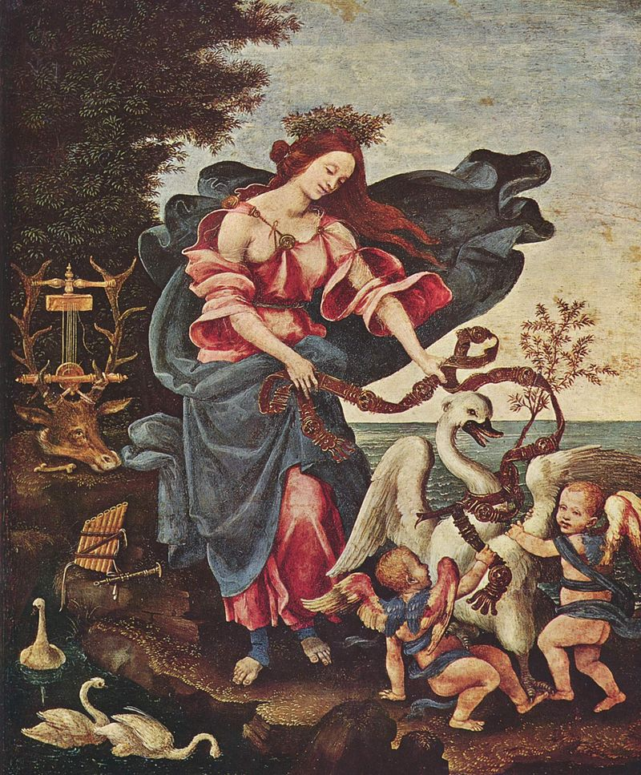
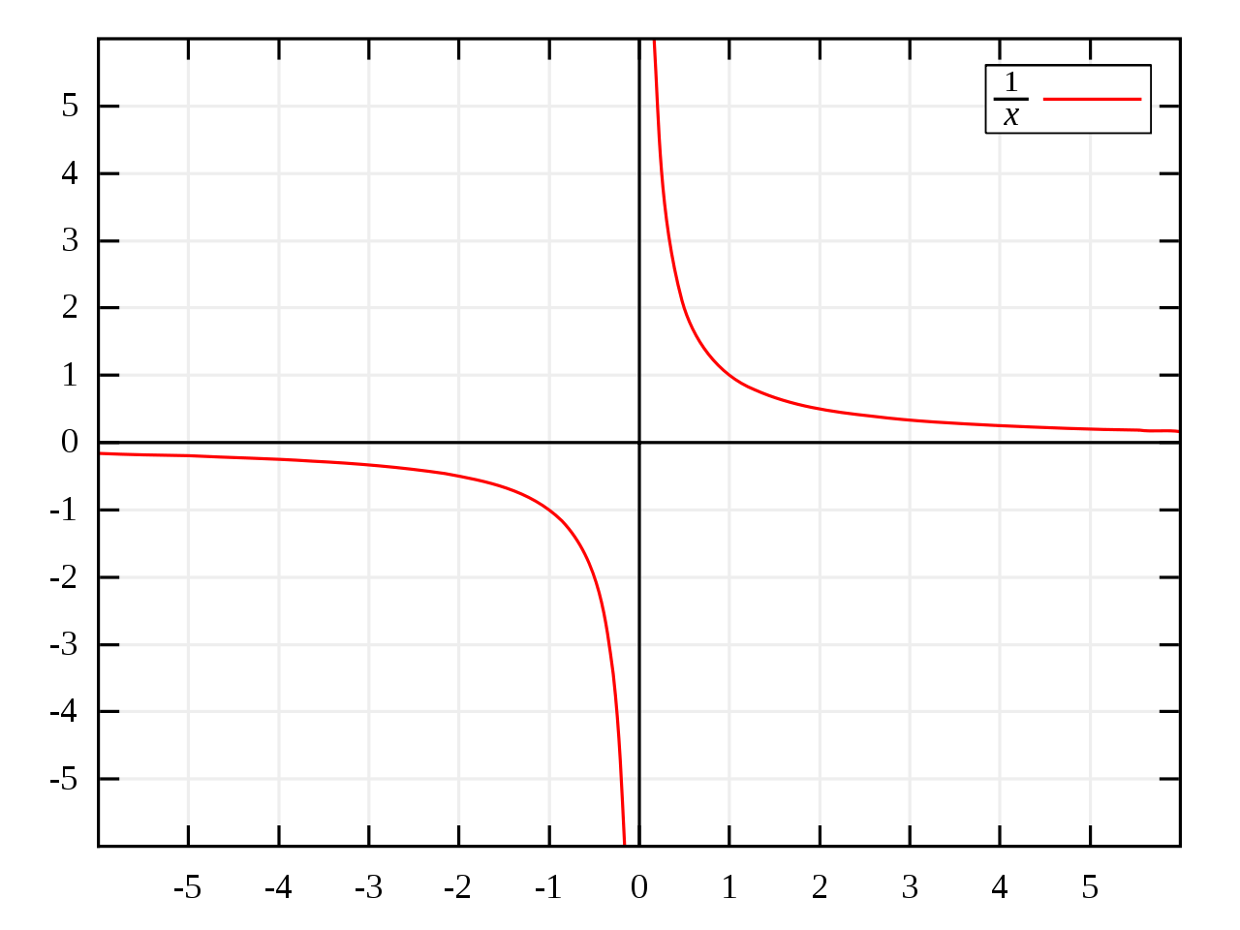
Allegory of Music, by Filippino Lippi
Deposition of a single copper
Atom on a copper surface

Slide 5

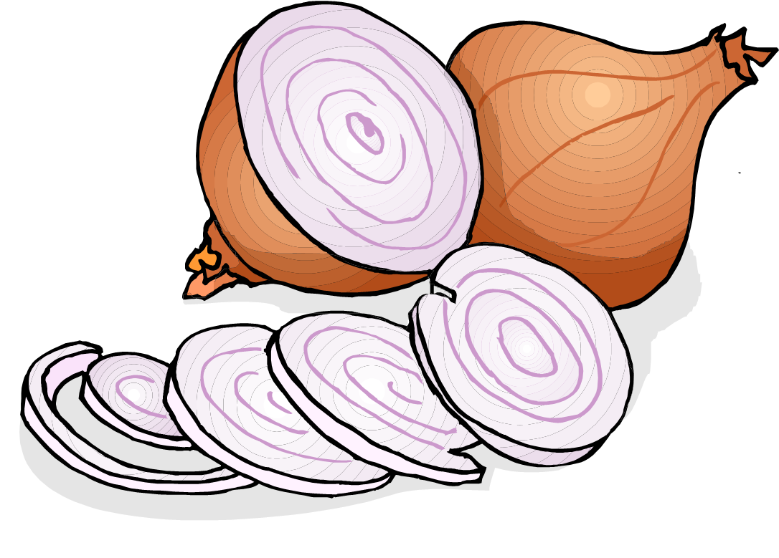
cation
anion = negative
onion
Paws = “paws”itive

Slide 6
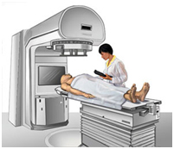
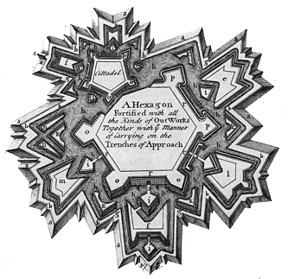

Slide 7
Illustration credits
Ribbons of memory ©Barbara Oakley, 2014.
Syria, by the UN Office for the Coordination of Humanitarian Affairs (OCHA) http://commons.wikimedia.org/wiki/File:Syria_-_Location_Map_(2013)_-_SYR_-_UNOCHA.svg
Allegory of Music by Filippino Lippi, (between 1475 and 1500), http://en.wikipedia.org/wiki/Allegory#mediaviewer/File:Filippino_Lippi_001.jpg
http://en.wikipedia.org/wiki/Molecular_dynamics, Example of a molecular dynamics simulation in a simple system: deposition of a single Cu atom on a Cu (001) surface. Each circle illustrates the position of a single atom; note that the actual atomic interactions used in current simulations are more complex than those of 2-dimensional hard spheres.
Monkeys in a ring, from Berichte der Durstigen Chemischen Gesellschaft (1886), p. 3536; benzene ring, modified from http://en.wikipedia.org/wiki/File:Benzene-2D-full.svg
Water flow analogy for electrical current by Professor Richard Vawter, http://faculty.wwu.edu/vawter/PhysicsNet/Topics/DC-Current/WaterFlowAnalog.html.
Hyperbola 1/x http://en.wikipedia.org/wiki/Division_by_zero#mediaviewer/File:Hyperbola_one_over_x.svg.
Fortification, from the 1728 Cyclopaedia, http://en.wikipedia.org/wiki/Fortification#mediaviewer/File:Table_of_Fortification,_Cyclopaedia,_Volume_1.jpg
Linear Accelerator Used for External-beam Radiation Therapy, National Cancer Institute, http://www.cancer.gov/cancertopics/factsheet/Therapy/radiation
Clip art courtesy Microsoft Corporation

Slide 8
Relevant Readings
Baddeley, Alan, Michael W. Eysenck, and Michael C. Anderson. Memory. NY: Psychology Press, 2009.
Cat, Jordi. "On Understanding: Maxwell on the Methods of Illustration and Scientific Metaphor." Studies In History and Philosophy of Science Part B 32, no. 3 (2001): 395-441.
Derman, Emanuel. Models. Behaving. Badly. New York, NY: Free Press, 2011.
Foer, J. Moonwalking with Einstein. NY: Penguin, 2011.
Lützen, Jesper. Mechanistic Images in Geometric Form. NY: Oxford University Press, 2005.
Maguire, E.A., D.G. Gadian, I.S. Johnsrude, C.D. Good, J. Ashburner, R.S.J. Frackowiak, and C.D. Frith. "Navigation-Related Structural Change in the Hippocampi of Taxi Drivers." Proceedings of the National Academy of Sciences 97, no. 8 (2000): 4398-403.
Maguire, E.A., E.R. Valentine, J.M. Wilding, and N. Kapur. "Routes to Remembering: The Brains Behind Superior Memory." Nature Neuroscience 6, no. 1 (2003): 90-95.
Rocke, A.J. Image and Reality. Chicago, IL: University of Chicago Press, 2010.
Solomon, Ines. "Analogical Transfer and 'Functional Fixedness' in the Science Classroom." Journal of Educational Research 87, no. 6 (1994): 371-77.

